Slide 1
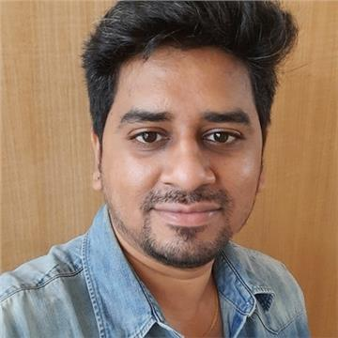
ARUN SINGH G SENIOR ASSOCIATE - 817840@cognizant.com
PROFILE SUMMARY
With over 10+ years of experience, including RPA, Python and Gen AI. I expertise in automation, process optimization, and project management.
INDUSTRIES
Life Science
Pharmaceutical Clinical Trials
Finance
HR
TECHNICAL SKILLS
UiPath Products
Python – Flask, Pandas, Seaborn
Power BI and Tableau
Kubernetes
AWS / Azure - CICD
CERTIFICATIONS
RPA Solution Architect(UiPath)
Python Certifications(Udemy)
EDUCATION
MCA from Anna University – 85%
Work Experience
Working closely with stakeholders, I ensure a thorough grasp of business objectives, devise comprehensive process designs, and implement solutions that elevate productivity, precision, and scalability, drawing on my expertise in Process Automation and QAE.
Beyond my technical capabilities, I take on the responsibility of leading code reviews and mentoring junior team members, guiding their skill development to unlock their full potential. I successfully executed a Proof of Concept utilizing the automation Test Suite.
Involved in IBM's Gen AI Watson-X workshops, we trained an AI model tailored to harness company-specific data for processing user inputs. This model integrates an NLP component to generate responses to user queries.
Additionally, I have innovatively designed an automation solution using ChatGPT and UiPath to assess the percentage match of a CV to a job, streamlining additional screening processes. Created a chatbot using Google dialog flow and UiPath to generate location specific reports on Covid status.
Developed custom/template web pages using HTML, CSS, JavaScript, and Flask frameworks for Python. I have designed and implemented RESTful web service using Flask and Python, resulting in a significant reduction in server response time.
I have acquired knowledge of serverless architectures and containerization technologies such as Docker and Kubernetes, facilitating the development and deployment of a service mesh solution based on Kubernetes.
I possess understanding in configuring and managing Amazon Web Services, including IAM, S3, and EC2, and am actively involved in establishing Continuous Integration/Continuous Deployment (CI/CD) pipelines using Git and Azure DevOps.
Leveraging a strong foundation in automation and process enhancement, I have developed over 50 UiPath bots that collectively reduce annual Average Handling Time (AHT) by over 10,000 hours, significantly boosting return on investment (ROI). I have also created multiple reusable components improving system performance, reducing downtime, and lowering expenses.
As a part of continues learning, I participated in the RPA UiPath Hackathon and Microsoft AI Odyssey Campaign, I have made significant contributions within the UiPath community forum, an open platform for discussing automation challenges.
Additionally, I have created numerous dashboards and reports using UiPath Insights to visually represent business data for stakeholder meetings and am certified in Tableau and Power BI.

